Slide 1

HIGH CLOUD AIRLINES ANALYTICS
Presented By:
ADARSH JS

Slide 2

Contents
Introduction
Objective
Business Overview
Data Model challenges
KPI’s Analysis
Dashboards
  Excel Dashboard
  Tableau Dashboard
  Power BI Dashboard
  SQL Query
Recommendation
Conclusion

Slide 3
Introduction
To revolutionize the airline industry through data-driven insights and optimization.
High Cloud Airline, a leading player in the aviation sector, has been at the forefront of providing seamless air travel experiences.
Established with a commitment to excellence, High cloud has consistently set industry standards in terms of reliability, safety and customer satisfaction.
Extensive network of routes spans across regions, connecting people and cultures, making High Cloud a preferred choice for millions of travelers globally.
High Cloud embraces innovation and modern technology to enhance operational efficiency and stay at the forefront of the aviation landscape.

Slide 4

Objective
To gain a comprehensive understanding of
“High Cloud Airlines” operations through data analysis. This will involve investigating load factors, identifying top carrier names based on passenger preference, analyzing popular routes, and exploring other key metrics. Additionally
The project focuses on boosting operational efficiency by Optimizing flight operation, reducing delays, and improving on-time performance. The ultimate goal is to provide actionable recommendations that can enhance operational efficiency and profitability.

Slide 5


Business Overview
In today’s competitive airline industry, data analysis plays a critical role in optimizing operations and maximizing profitability. By harnessing the power of data, High Cloud Airlines can gain valuable insights into various aspects of its business, allowing them to make data-driven decisions that can lead to
Improved load factor
Enhance Passenger Experience Optimized resource allocation Data- Driven Decision Making

Slide 6

Data Model challenges
Throughout our analysis, we encountered various challenges in handling the data. Overcoming these challenges is crucial for accurate insights.
Data Volume: Managing and Processing large datasets efficiently.
Data Quality: Ensuring accuracy and reliability of the data.
Complex Relationships: Establishing connections between different data points.
Errors and Duplicates: Cleaning data to fix incorrect values and remove duplicates.
Outliers: Flagging and handling unusual data for accuracy.

Slide 7




KPI’s Analysis
Date Fields (Year, Month, Quarter, etc.):
  Identify seasonal trends and busiest periods for better planning.
  Spot weekday vs. weekend travel patterns to allocate resources effectively.
Load Factor Percentage (Yearly, Quarterly, Monthly):
  Monitor seat utilization efficiency.
  Highlight underutilized periods for improvement or cost reduction.
Load Factor by Carrier:
  Compare carrier performance in seat utilization.
  Identify top-performing and underperforming carriers.
Top 10 Carriers by Passengers:
  Reveal most popular carriers.
  Focus on improving customer experience for less-preferred carriers.
Top Routes (From-To City):
  Highlight busiest routes for better scheduling and resource allocation.
  Identify routes with growth potential or need for additional flights.
Load Factor: Weekends vs. Weekdays:
  Understand leisure vs. business travel trends.
  Optimize pricing strategies for weekends and weekdays.
Flight Search Filter (Source to Destination):
  Analyze popular routes and demand patterns for better route planning.
Flights by Distance Groups:
  Identify demand for short-haul, medium-haul, and long-haul flights.
  Optimize aircraft allocation and explore new opportunities.

Slide 8
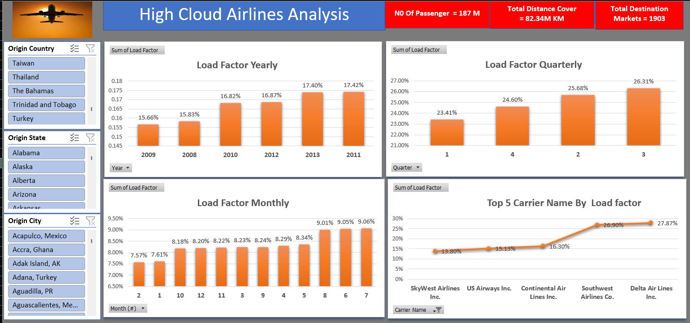
Excel Dashboard-1

Slide 9
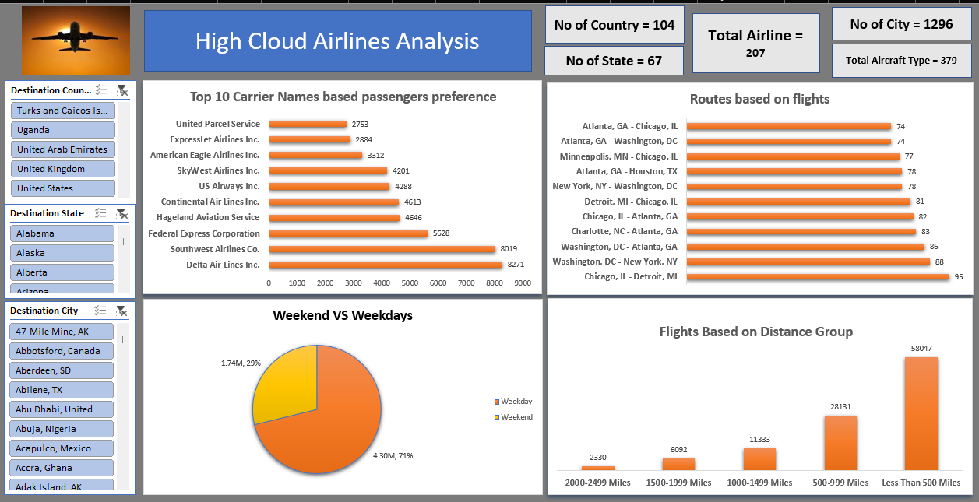
Excel Dashboard-2

Slide 10
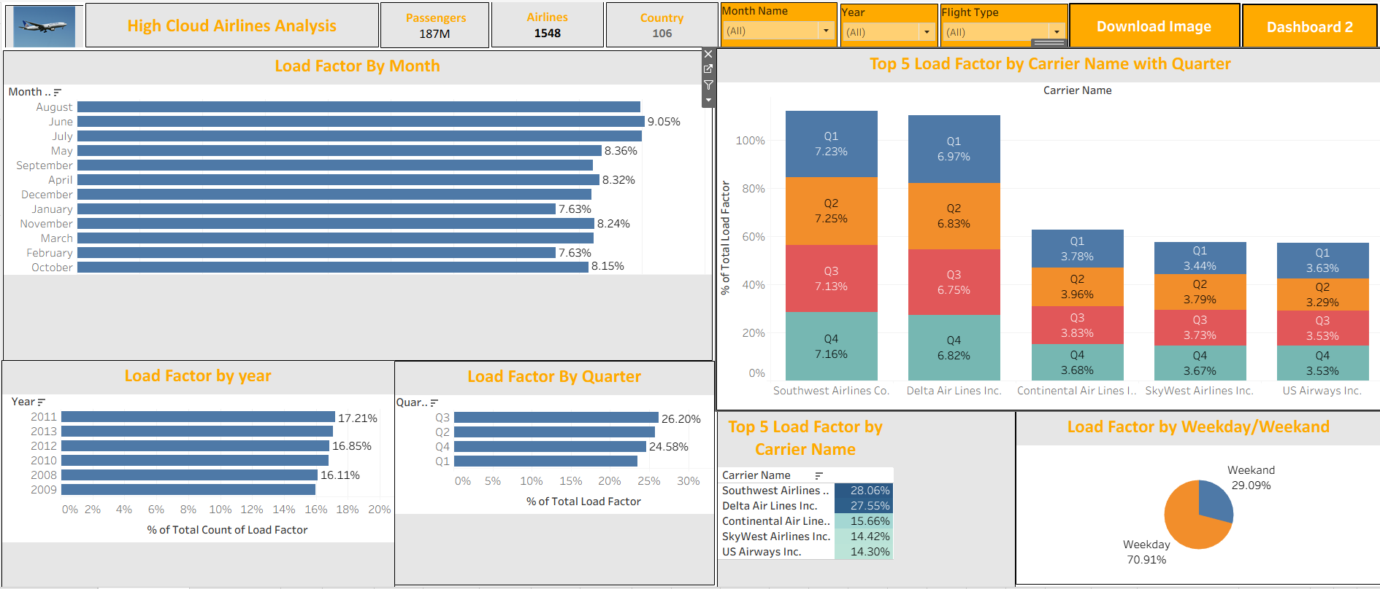
Tableau- Dashboard-1

Slide 11
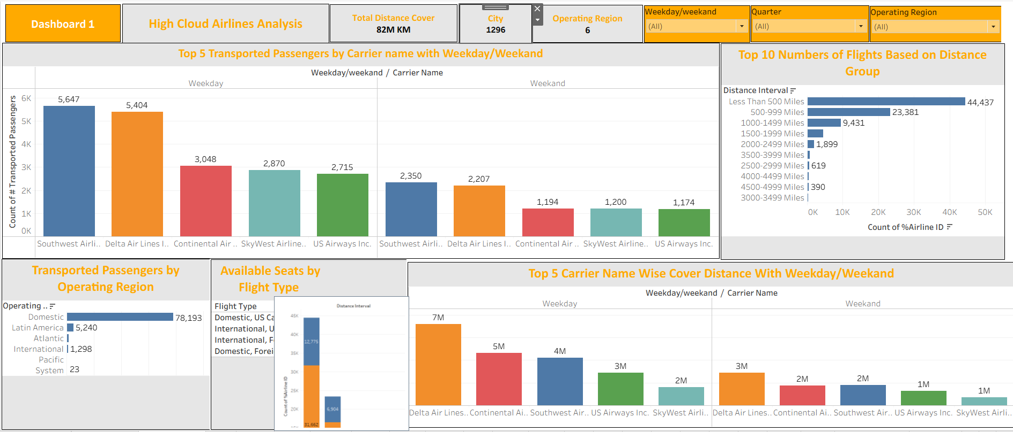
Tableau- Dashboard-2

Slide 12
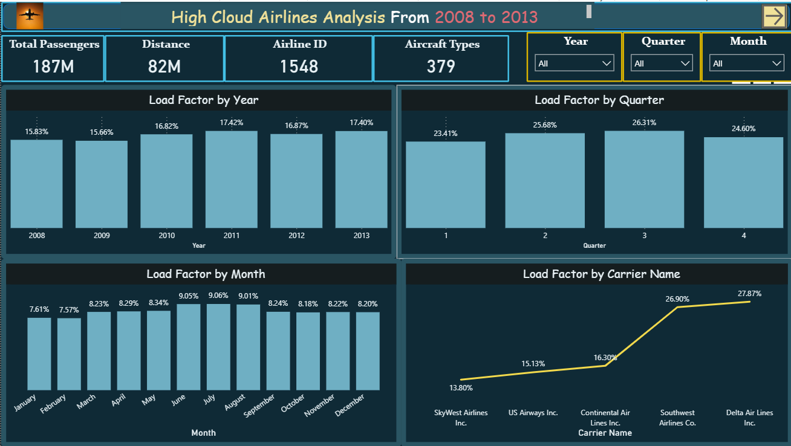
Power BI – Dashboard 1

Slide 13
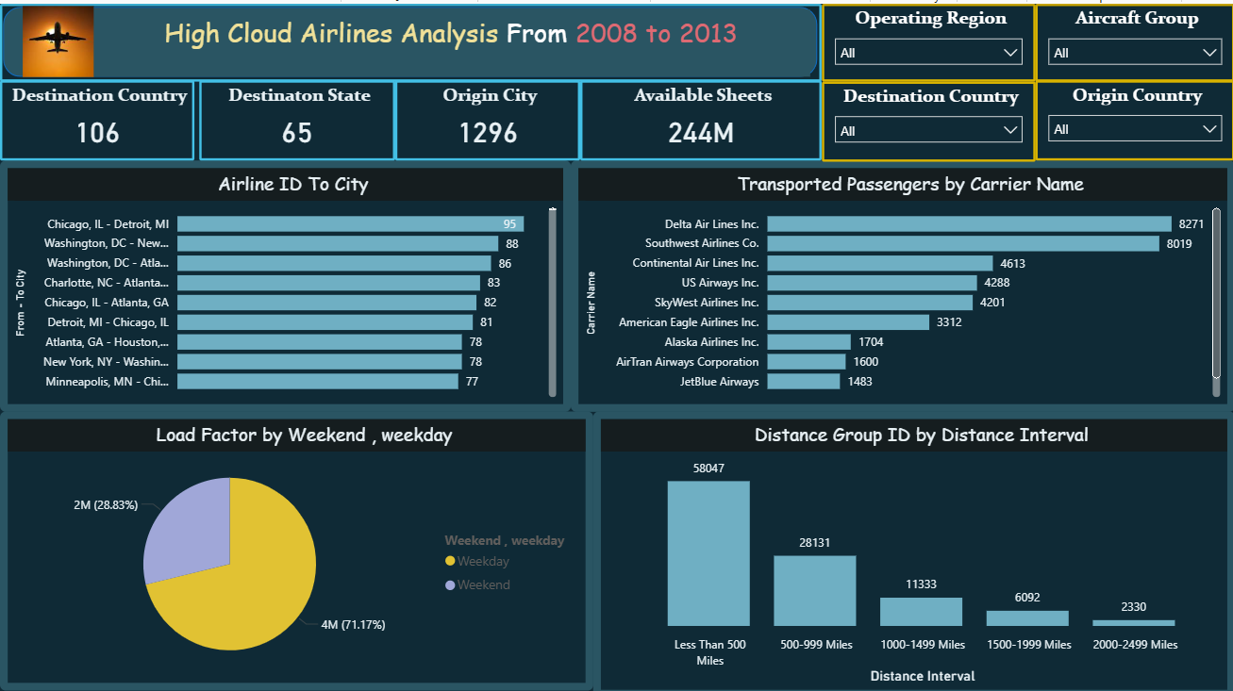
Power BI –Dashboard 2

Slide 14

MYSQL- Queries
-- Year
SELECT DISTINCT YEAR(Datefiled) AS Year
FROM high_cloud_flights;
-- Month Number
SELECT DISTINCT MONTH(Datefiled) AS MonthNo
FROM high_cloud_flights;
-- Month Name
SELECT DISTINCT MONTHNAME(Datefiled) AS MonthFullName
FROM high_cloud_flights;
-- Quarter
SELECT DISTINCT CONCAT('Q', QUARTER(Datefiled)) AS Quarter
FROM high_cloud_flights;

Slide 15

MYSQL- Queries
-- Year-Month
SELECT DISTINCT DATE_FORMAT(Datefiled, '%Y-%b') AS YearMonth
FROM high_cloud_flights;
-- Weekday
SELECT DISTINCT
WEEKDAY(Datefiled)+1 AS WeekdayNo,
DAYNAME(Datefiled) AS WeekdayName
FROM high_cloud_flights;

Slide 16

MYSQL- Queries
-- Financial Month
SELECT Datefiled,
CASE
WHEN MONTH(Datefiled) >= 4 THEN CONCAT('FM', MONTH(Datefiled)-3)
ELSE CONCAT('FM', MONTH(Datefiled)+9)
END AS FinancialMonth
FROM high_cloud_flights;
-- Financial Quarter
SELECT Datefiled,
CASE
WHEN MONTH(Datefiled) BETWEEN 4 AND 6 THEN 'FQ1'
WHEN MONTH(Datefiled) BETWEEN 7 AND 9 THEN 'FQ2'
WHEN MONTH(Datefiled) BETWEEN 10 AND 12 THEN 'FQ3'
ELSE 'FQ4'
END AS FinancialQuarter
FROM high_cloud_flights;

Slide 17

MYSQL- Queries
-- By Year
SELECT YEAR(Datefiled) AS Year,
ROUND(SUM(`# Transported Passengers`) /
SUM(`# Available Seats`) * 100, 2) AS LoadFactorPercent
FROM high_cloud_flights
GROUP BY YEAR(Datefiled);
-- By Quarter
SELECT CONCAT('Q', QUARTER(Datefiled)) AS Quarter,
ROUND(SUM(`# Transported Passengers`) /
SUM(`# Available Seats`) * 100, 2) AS LoadFactorPercent
FROM high_cloud_flights
GROUP BY CONCAT('Q', QUARTER(Datefiled));
-- By Month
SELECT MONTHNAME(Datefiled) AS Month,
ROUND(SUM(`# Transported Passengers`) /
SUM(`# Available Seats`) * 100, 2) AS LoadFactorPercent
FROM high_cloud_flights
GROUP BY MONTH(Datefiled), MONTHNAME(Datefiled);

Slide 18

MYSQL- Queries
-- Load Factor by Carrier
SELECT `Carrier Name`,
ROUND(AVG(`# Transported Passengers`*1.0 /
`# Available Seats`) * 100, 2) AS LoadFactorPercent
FROM high_cloud_flights
WHERE `# Available Seats` > 0
AND `# Transported Passengers` > 0
AND `%Service Class ID` IN ('L','F')
GROUP BY `Carrier Name`;
-- Top 10 Carriers
SELECT `Carrier Name`,
SUM(`# Transported Passengers`) AS TotalPassengers
FROM high_cloud_flights
GROUP BY `Carrier Name`
ORDER BY TotalPassengers DESC
LIMIT 10;

Slide 19

MYSQL- Queries
-- Top Routes
SELECT `From - To City`,
COUNT(*) AS NumberOfFlights
FROM high_cloud_flights
GROUP BY `From - To City`
ORDER BY NumberOfFlights DESC
LIMIT 10;
-- Weekend vs Weekday
SELECT CASE
WHEN DAYOFWEEK(Datefiled) IN (1,7) THEN 'Weekend'
ELSE 'Weekday'
END AS DayType,
ROUND(SUM(`# Transported Passengers`) /
(SELECT SUM(`# Transported Passengers`)
FROM high_cloud_flights) * 100, 2) AS PassengerSharePercent
FROM high_cloud_flights
GROUP BY DayType;

Slide 20

MYSQL- Queries
-- Source to Destination Filter
SELECT *
FROM high_cloud_flights
WHERE `Origin Country` = 'United States'
AND `Origin State` = 'Alaska'
AND `Origin City` = 'Nome, AK'
AND `Destination Country` = 'United States'
AND `Destination State` = 'Alaska'
AND `Destination City` = 'Bethel, AK';
-- Distance Group
SELECT CASE `%Distance Group ID`
WHEN 1 THEN 'Less Than 500 Miles' WHEN 2 THEN '500–999 Miles' WHEN 3 THEN '1000–1499 Miles' WHEN 4 THEN '1500–1999 Miles' WHEN 5 THEN '2000–2499 Miles' WHEN 6 THEN '2500–2999 Miles' WHEN 7 THEN '3000–3499 Miles' WHEN 8 THEN '3500–3999 Miles' WHEN 9 THEN '4000–4499 Miles' WHEN 10 THEN '4500–4999 Miles'
WHEN 11 THEN '5000–5499 Miles' WHEN 12 THEN '5500–5999 Miles' WHEN 13 THEN '6000–6499 Miles' WHEN 14 THEN '6500–6999 Miles' WHEN 15 THEN '7000–7499 Miles' WHEN 16 THEN '7500–7999 Miles' WHEN 17 THEN '8000–8499 Miles' WHEN 18 THEN '8500–8999 Miles' WHEN 19 THEN '9000–9499 Miles' WHEN 20 THEN '9500–9999 Miles' ELSE 'Unknown' END AS DistanceInterval,
COUNT(*) AS NumberOfFlights
FROM high_cloud_flights
GROUP BY `%Distance Group ID`;

Slide 21

Recommendation
Optimize Fight Routes: Utilize insights from up routes and flights to Optimize schedule and resource allocation.
Enhance Load Factor: Leverage load factor analysis to identify trends and implement strategies for increased efficiency.
Strategic Carrier Partnership: Collaborate with top carriers to maximize passenger transportation and enhance overall performance.
Resource Allocation: Allocate resources strategically based on flight schedules and passenger volume data. This ensures efficient operation and minimizes wait times at airports with high passenger traffic.

Slide 22
Conclusion
High Cloud Airlines empowers the aviation industry with actionable insights, foresting efficiency, and strategic decision-making. The presented KPIs offer a glimpse into the vast potential for improvement and growth within the industry. By harnessing the power of data, we can drive positive changes, ensuring a bright future for High Cloud Airlines and its partners in the aviation sector.

Slide 23

Thank You

